Slide 1
MyBank Banking application
Team: Wealth Warriors
Module: Insurance Application

Slide 2
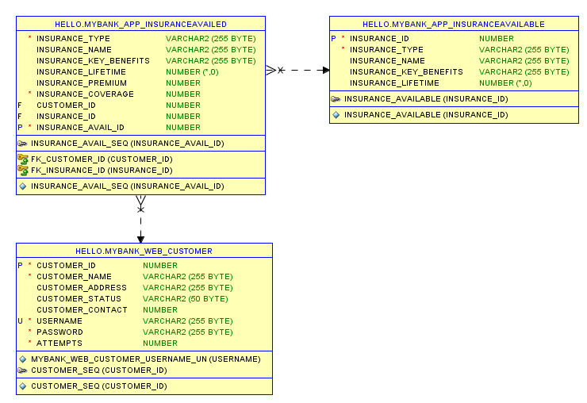
Database design

Slide 3
VIEW INSURANCE MODULE:
Upon the successful login, we provide a menu of insurance types.
View All Insurance type: Displays a list of all insurance types available in the database . It has attributes
INSURANCE_ID
INSURANCE_TYPE
INSURANCE_NAME
INSURANCE_KEY_BENEFITS
INSURANCE_LIFETIME

Slide 4
POST INSURANCE MODULE:
Upon the successful login, we provide a menu of insurance types.
Apply for Insurance : user applies for the insurance through the form. Below given are the attributes
INSURANCE_TYPE
INSURANCE_NAME
INSURANCE_KEY_BENEFITS
INSURANCE_LIFETIME
INSURANCE_PREMIUM
INSURANCE_COVERAGE
CUSTOMER_ID
INSURANCE_ID
INSURANCE_AVAIL_ID

Slide 5
INSURANCE MODULE:
Upon the successful login, we provide a menu of insurance types.
Search by insurance id : User searches for the insurance available based on the insurance id. Below given are the attributes
INSURANCE_TYPE
INSURANCE_NAME
INSURANCE_KEY_BENEFITS
INSURANCE_LIFETIME
INSURANCE_PREMIUM
INSURANCE_COVERAGE
CUSTOMER_ID
INSURANCE_ID
INSURANCE_AVAIL_ID

Slide 6
INSURANCE MODULE:
Upon the successful login, we provide a menu of insurance types.
Search by insurance coverage amount: User searches for the insurance availed based on the range of coverage amount. Below given are the attributes
INSURANCE_TYPE
INSURANCE_NAME
INSURANCE_KEY_BENEFITS
INSURANCE_LIFETIME
INSURANCE_ID

Slide 7
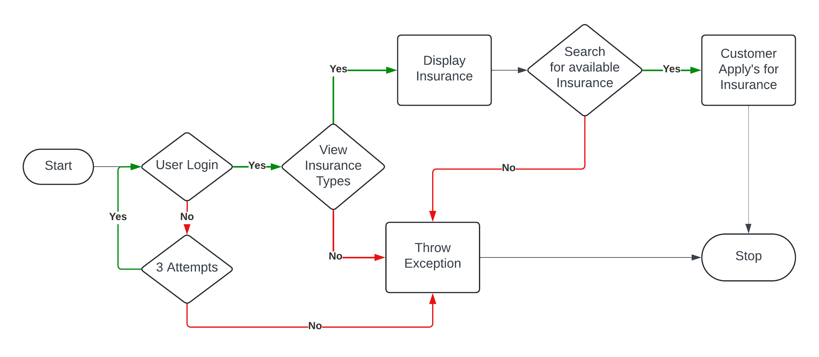
Data Flow Diagram

Slide 8
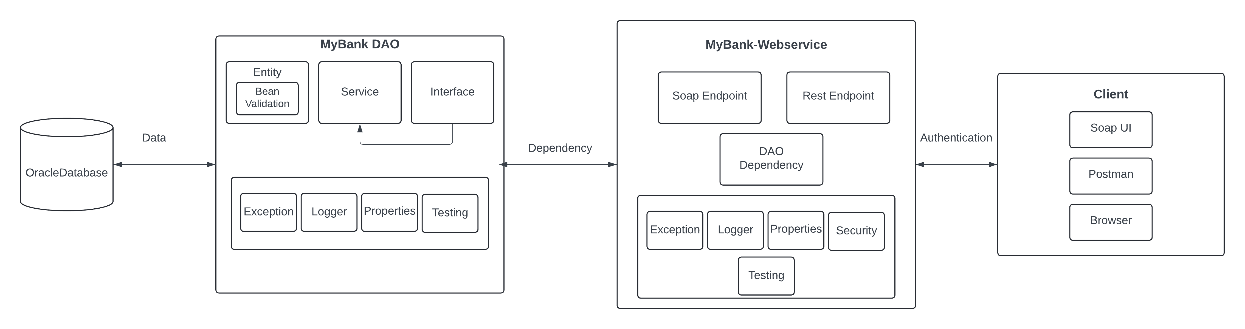
Project Structure:

Slide 9
Links and Files
Git hub link- DLTE-Java-Full-Stack-ElroyMerwynMonis-2024/DLTE-MyBank-Project at master · elroy26/DLTE-Java-Full-Stack-ElroyMerwynMonis-2024 (github.com)
Jar File- DLTE-Java-Full-Stack-ElroyMerwynMonis-2024/DLTE-MyBank-Project/MyBank-Insurance-Dao/target/insurancedao-0.0.1-SNAPSHOT.jar at master · elroy26/DLTE-Java-Full-Stack-ElroyMerwynMonis-2024 (github.com)

Slide 10

Thankyou

